Slide 1















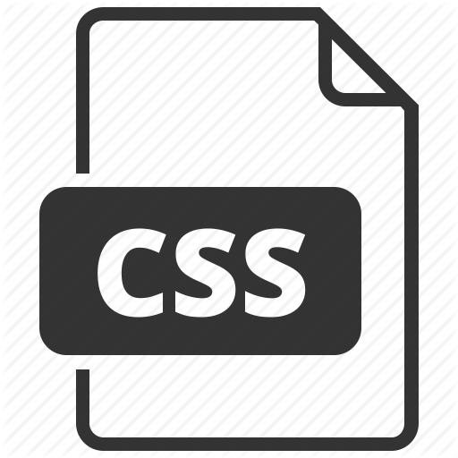
App Dev Process –Waterfall + 3GL
Cloud
Application
Business
Business
Analyst
Functional
Requirements
Technical
Analyst
Technical
Specifications
Project
Manager
Operations
Test
Report
DBA
Developers
UI/UX
Database
Code
CSS
Tester

Slide 2
App Dev Process –Agile + 3GL
Cloud
Reviews
Application
Business
Analyst
Business
Product
Owner
User Stories
Scrum
master
Operations
Tech Lead
DBA
Developers
UI/UX
Tester
Design
Database
Code
CSS
Report

Slide 3
App Dev Process –Agile + DevOps + 3GL
Cloud
Reviews
Application
Business
Analyst
Business
Product
Owner
User Stories
Scrum
master
DBA
Developers
UI/UX
Tester
Operations
Tech lead
Design
Database
Code
CSS
Report
Infra

Slide 4

OS Dev Process –Agile + DevOps + LowCode
Application
Cloud
Business
Developer
Developer
Product
Owner
User Stories
Model
Business
Analyst

Slide 5




The Mendix Development Process = Agile + DevOps + Low code + Collaboration = BizDevOps
Application
Cloud
Business = PO
User
Stories
Business
Analyst
Developer
Model

Slide 6
The Mendix Development Process = Agile + DevOps + Low code + Collaboration = BizDevOps
Application
Cloud
Business = PO
User
Stories
Business
Analyst
Developer
Model
UI/UX
Private App Store
Operations
DBA
Tester

